Slide 1
Online Hostel management system
WELCOME TO OUR PRESENTATION
Topic

Slide 2


Team members
MD.Rasel Hossain
Department of CSE
ID:163432521
Batch:43rd
MD.Abul Hossain
Department of CSE
ID:1634325
Batch:43rd

Slide 3
Background Study
The hostel management system is web based system to provide hostel. The software will be great relief to the employees. This system also keeps details of the hostellers and applied borders. Its automatically select the students from the mess calculation, complaint registration, notice board etc.

Slide 4
Features
Borders login
Admin login
Registration option
Room chooses & availability factuality
Dyning Management system
Online hotel system saves time spent on manual updates
Access to a single dashboard to control all functions

Slide 5
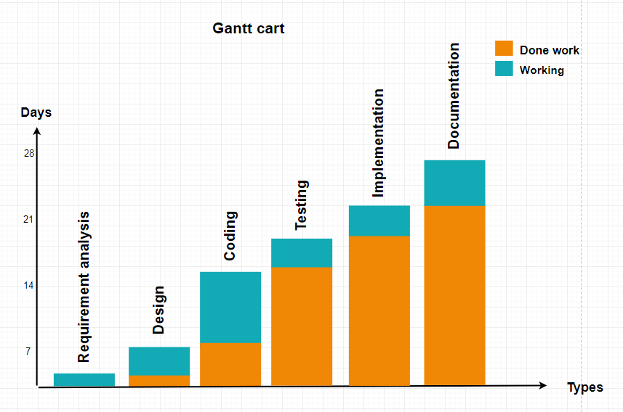
Gantt chart

Slide 6
Software Requirements
XAMPP server
Language Used
Front End(User Interface) HTML 5 , CSS,JAVASCRIPT
Server Language PHP
Back End MYSQL

Slide 7
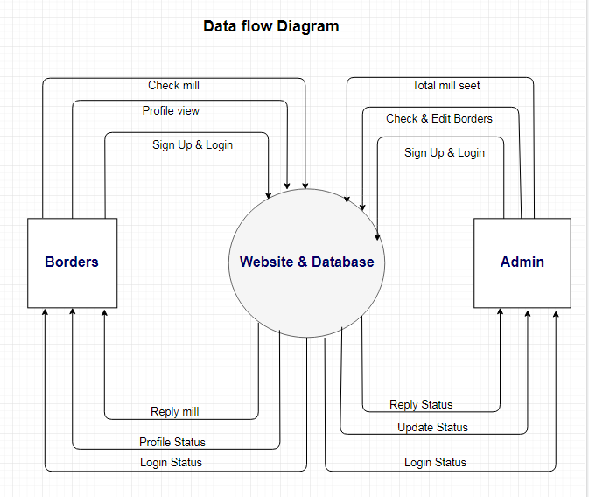
Data flow diagram

Slide 8
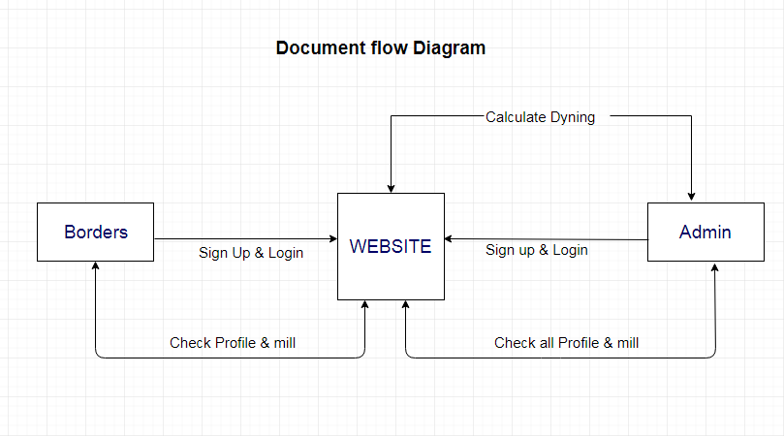
Document flow diagram

Slide 9
Contribution
The existing system is manual based and need lot of efforts and consume enough time. In the existing system we can apply for the hostels online.
CONCLUSION
To conclude the description about the project developed using PHP with MySQL. It’s based on the requirement specification of the user and analysis of the existing system, with flexibility for future enhancement. Online HOSTEL MANAGEMENT SYSTEM is very useful for mess fee calculation.

Slide 10


